Slide 1
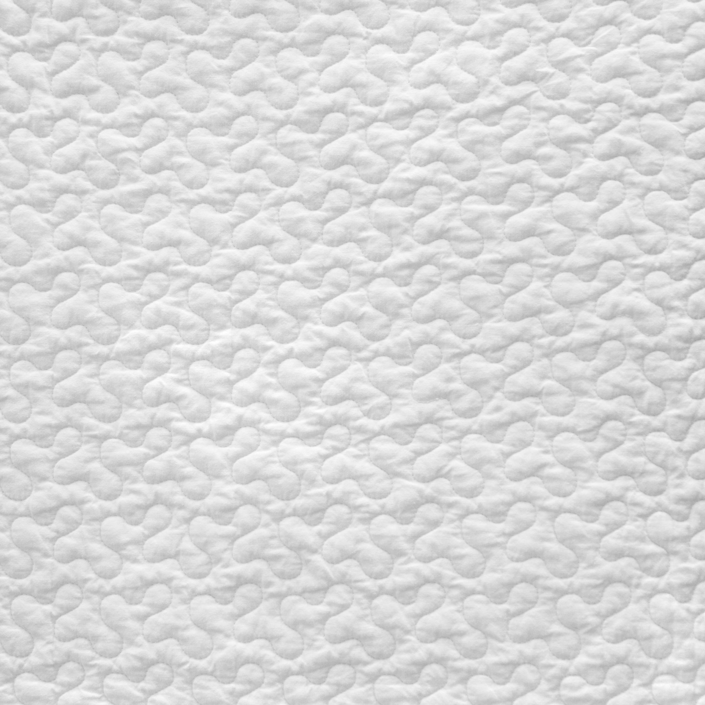
Quilt Makers
From QuiltIndex.org

Slide 2

About the QuiltIndex.org
Digital repository of images, stories and information about quilts
Drawn from hundreds of public and private collections around the world
Contains the most expansive and accessible quilt resource available online
Represents years of research and development to bring together quilt information in a centralized online tool for education, research, and public access
Notes:
One of the first attempts to digitally document a massive number of physical objects.
The beginnings - quilt historians and quilt guilds in ‘80s and ‘90s who documented quilts on paper and created quilt history projects.
A huge undertaking to get all the data from all the different institutions and find a common data structure that could contain all the data in a consistent way

Slide 3
Contributors
Wisconsin Quilt History Project, Arizona Quilt Documentation Project, American Folklife Center, Library of Congress, Royal Alberta Museum Archives; Alberta Quilt Study Society, Florida Quilt Project, Sunshine State Quilters Association, University of Nebraska - Lincoln, Quilt Alliance, Rutgers Special Collections and University Archives, Beaver County Historical Research and Landmarks Foundation, International Quilt Museum, Louisiana Regional Folklife Program, Louisiana Tech University, North Carolina Museum of History, Michigan State University Museum, Indiana State Museum, West Virginia Department of Archives and History, Minnesota Quilters Inc., Lebanon Quilters Guild and the Lebanon County Historical Society, Wyoming Quilt Project, Inc., McKissick Museum, University of South Carolina, Rocky Mountain Quilt Museum, University of Louisville Archives and Records Center, Connecticut Quilt Search, University of Rhode Island, New Hampshire Quilt Documentation Project, Phase II, Massachusetts Quilt Documentation Project - MassQuilts, Briscoe Center for American History, University of Texas at Austin, National Quilt Museum, Tennessee State Library and Archives, Kansas State Historical Society, American Folk Art Museum, State Historical Society of Iowa, Blythewood Historical Society, White Bluffs Quilt Museum, Kent County, MD Quilt Documentation Project, Museum of Texas Tech University, Textile Research Centre (TRC) Leiden, Illinois State Museum, Signature Quilt Pilot Project, Merikay Waldvogel Legacy Project, Public Submission, Country Heritage Park, Women of Color Quilters Network, South Africa Quilt History Project, Hawaiian Quilt Research Project, Black Diaspora Quilt History Project, Oregon Quilt Project, Royal Alberta Museum, Claire Vlasin Quilt Collection, Indiana University Museum of Archaeology and Anthropology, Quilts and Health, Kenan Research Center, Atlanta History Center, DAR Museum, Quilts and Human Rights Project at Michigan State University Museum, Mountain Heritage Center, Washington State African American Quilt Documentation Project, Mary Gasperik Legacy Project, Louisiana Regional Folklife Program, China Quilt Project, Quilts and Human Rights, NAMES Project AIDS Memorial Quilt, Michigan State Unversity Museum, Wilene Smith Private Collection, Individual contributors
Notes:
Look! There are A LOT of contributing institutions. And don’t forget individual contributors too!

Slide 4
About the data
93,229 records about quilts
Collected by many different institutions and individuals
Acquired over many decades, with a large portion in 1980s
Data was collected by groups before the QuiltIndex started
Each group had their own fields and formatting for collecting data
Quilt data collection began with paper records and moved to digital
Data was collected as free-form data - no consistent formatting
Notes:
One of the biggest struggles for data analysis of this data is the inconsistency in format of data fields. It’s what a data analyst would call “messy data”.
That’s an actual technical term in data analysis. It’s not a judgement about the data or the data collectors.

Slide 5
Example inconsistencies - date formatting
Most quilt owners (who are not the quilt maker) know very little about exact dates that quilts were made or when quilt makers were born. We can see from the diversity of date formatting that owners gave the best information they had.
c.1961
10/20/1818
05-10-1945
Prior to 1850
1887
April 28, 1927
1890 July 26
February 4, 1901
early 1880s
c1863
Saturday, August 25, 1945
About 1857
Notes:
This is a list of actual data from the dataset. This type of data collection is really great for getting the most information. “early 1880s” gives us much more information then blank data would. It works really well for ONE human looking at ONE record and getting as much information as possible about that record. It only becomes a problem when we want to look at thousands of records using a program instead of a human.

Slide 6
About the maker data
This is not a random sample of quilt makers
The maker is only documented if there is a quilt in the QuiltIndex. The quilt owner (who is often not the quilt maker) chooses which quilts to enter into QuiltIndex.
Many records of makers were incomplete, because most antique quilts are unsigned and the makers unknown. Even when the maker is known, information about the maker can be difficult to collect.
For this analysis, maker records were analyzed if they had all of:
Country
Birth country
Quilt country
Birth date
Quilt date or time period
Gender
Notes:
Notice that name is not required for the maker record. Unnamed makers were assigned a unique value to use as a name to distinguish them from each others during analysis.

Slide 7
Duplicate makers
A maker with more than one quilt could be entered multiple times
Determining which makers are duplicates required a tricky deduplication
Nicknames
Typos
Common variations of names (Van Dike, VanDike)
Additional middle names, maiden names
Additional non-name information
Name formatting
For example, is this the same person?
Smyth, Catherine Louisa
Smithe, Katharine Louise
Smythe, Kathy Louisde (1864 - 1932)
Kathie Smythe
Birth date year was used to help untangle the duplicates

Slide 8
The final numbers for the maker analysis
Once incomplete and duplicate records were removed from the analysis the final count for quilt makers was:
3440
And the number of quilts that were made by those makers was:
5602
This was the data that was analyzed

Slide 9
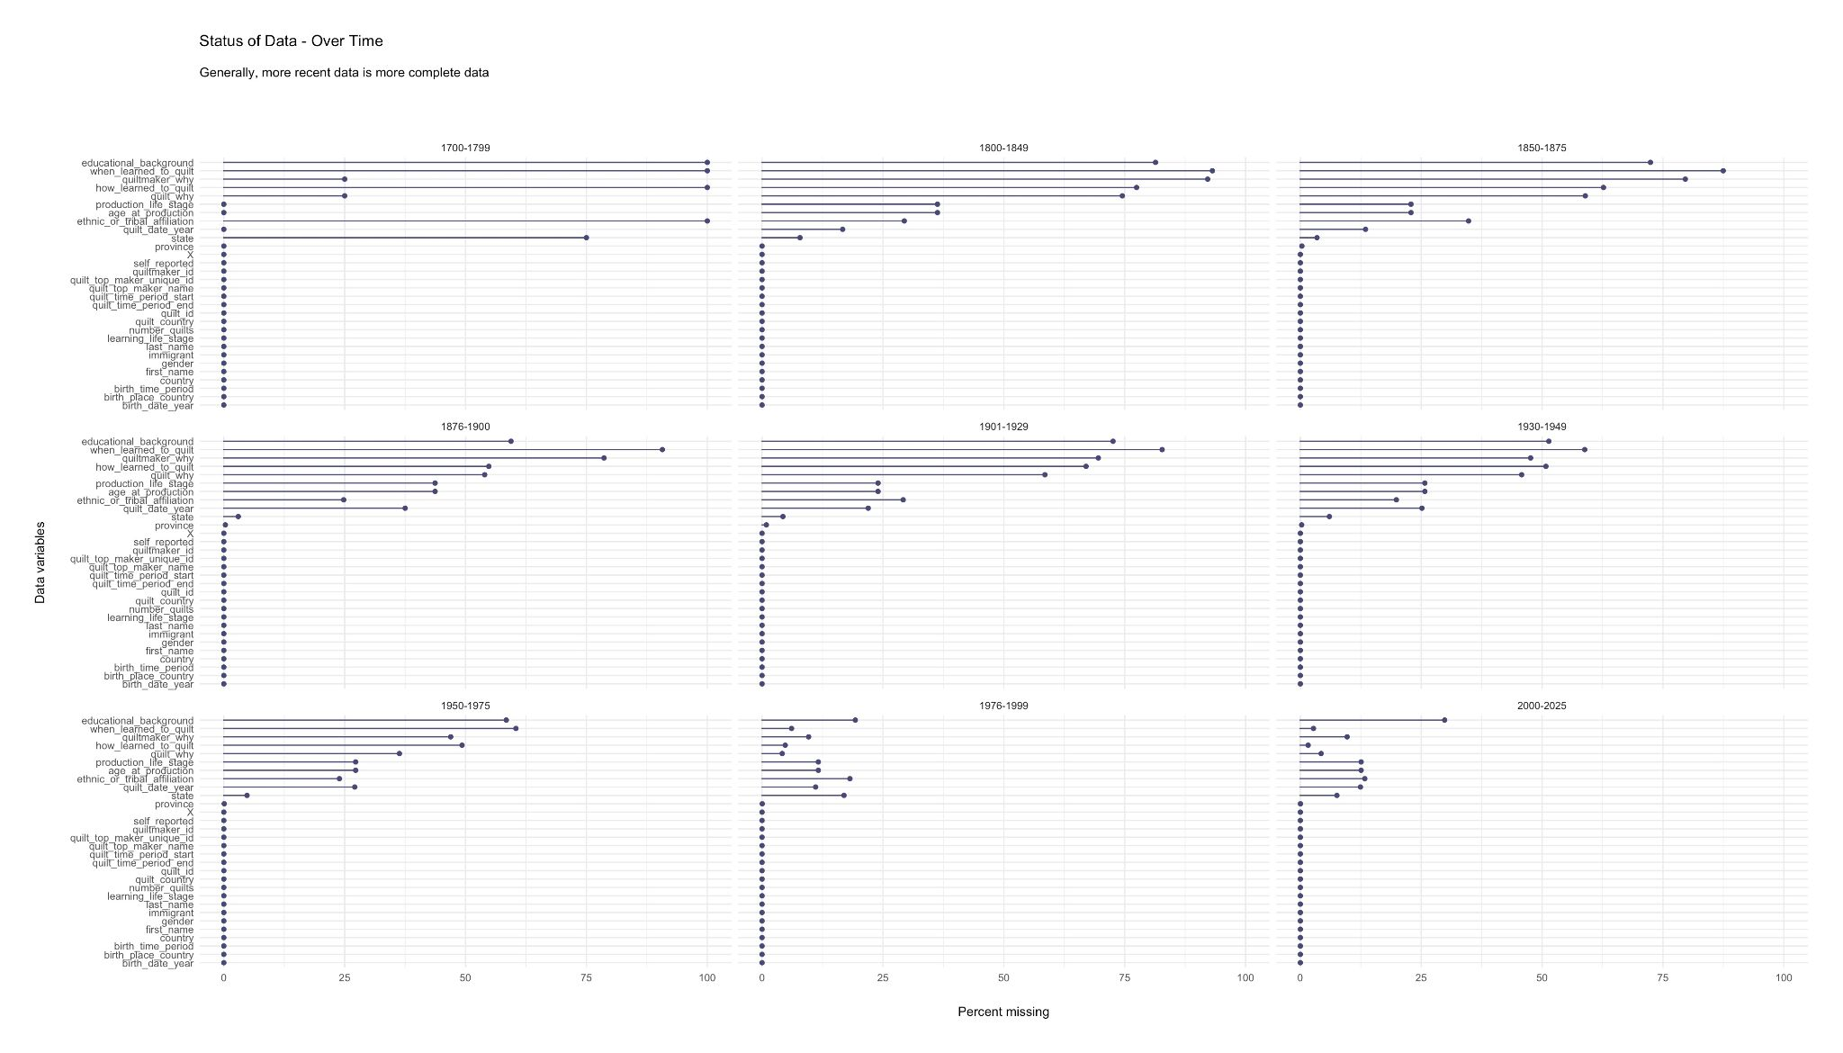
Notes:
Here we see the different data variables we are analyzing and the blue bars show percent of that variable which is missing. So more blue bars means more missing data.
It isn’t surprising to find that we have more data about more recent quilts.
So what about the quilts in 1700-1799 that have some extra data? The few quilts that have survived from this time period are either very sentimental or very beautiful or both - probably contributing to the care of both the quilt and the quilt data by the owners.

Slide 10
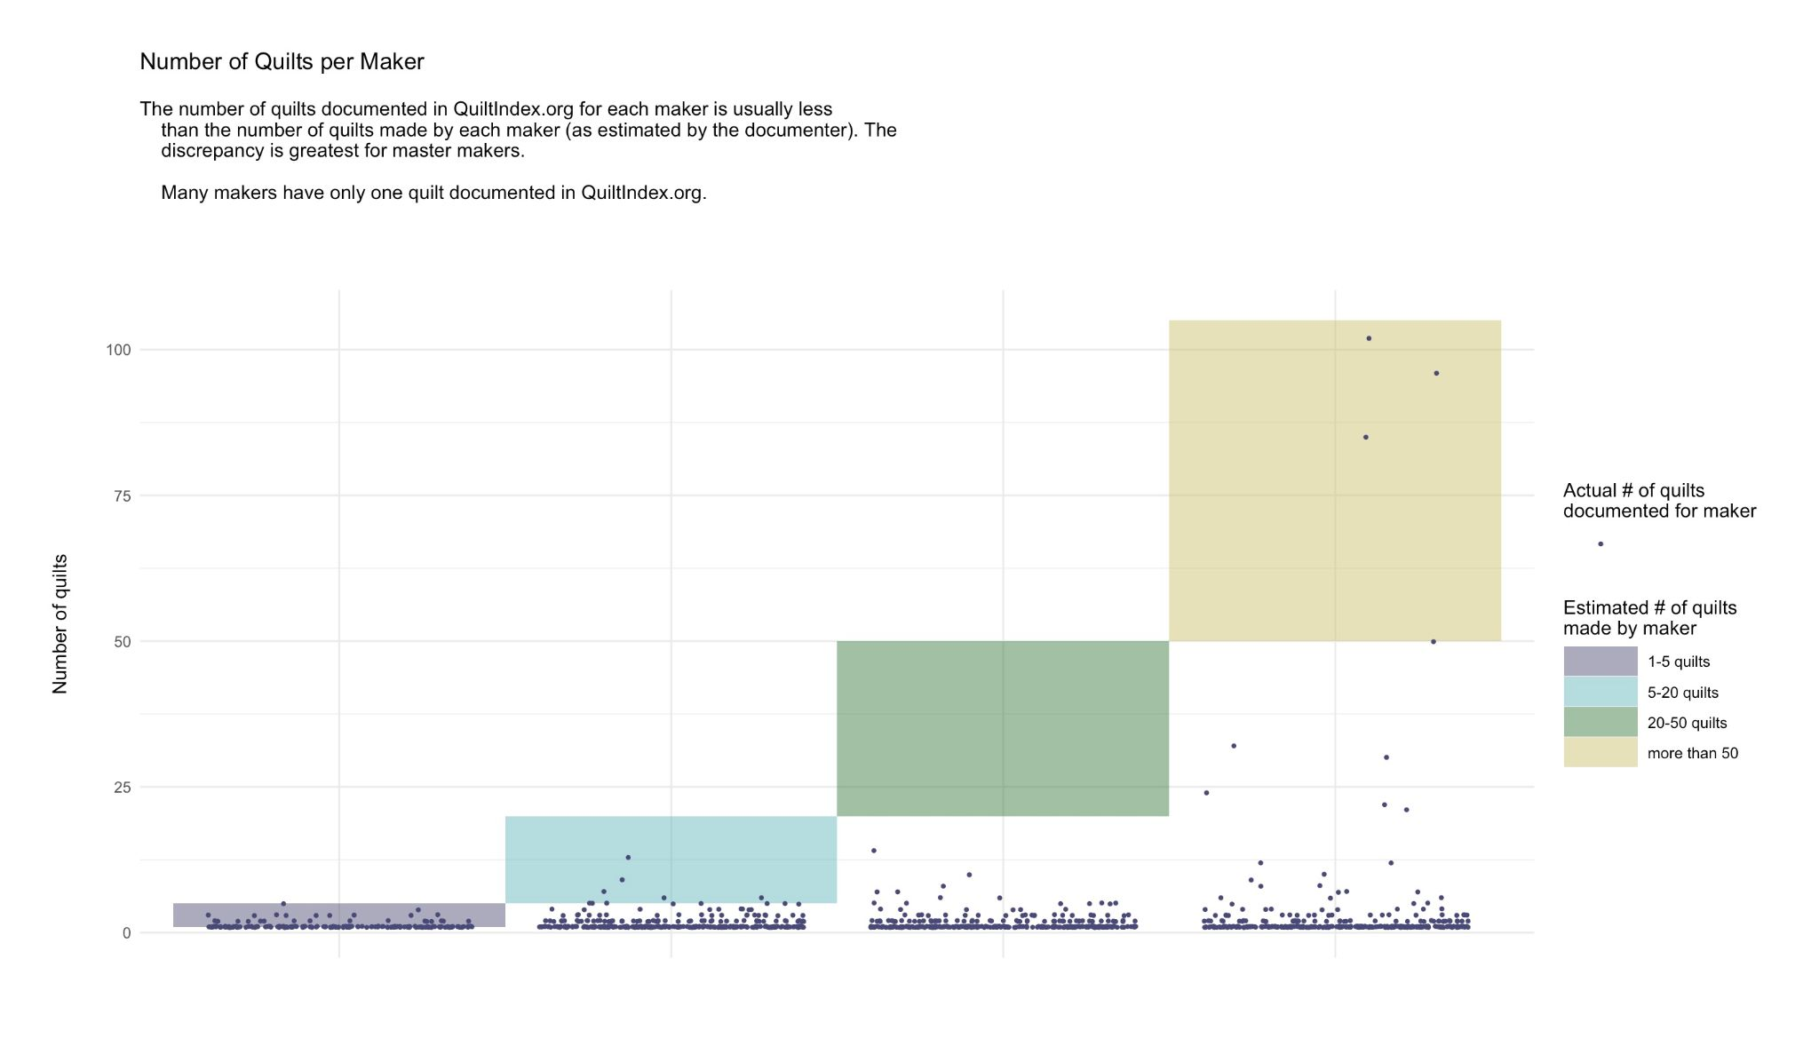
Notes:
Even for the makers who are in the index, we often don’t have their entire quilt oeuvre documented. You can see the almost solid line at 1 number of quilts. This shows how very many of the makers have just one quilt in the quilt index.

Slide 11
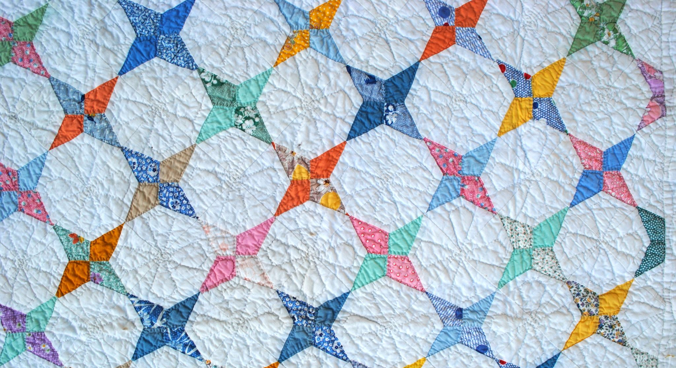
Notes:
So that’s the information about the quilt index and about the status of the quilt data. Now it’s time to actually find out about the quilt makers.

Slide 12
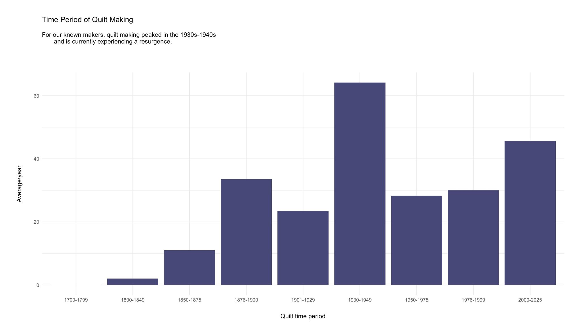
Notes:
A reminder here: the analysis includes the 3440 makers that had complete (as defined by this analysis) records and their 5602 quilts. This analysis does not cover the 93,229 quilts that are available in the QuiltIndex. We must remember that this analysis is done on a subset of records in QuiltIndex, which is itself a subset of quilt making itself. This analysis is giving us a peek into that world - not a comprehensive review.

Slide 13
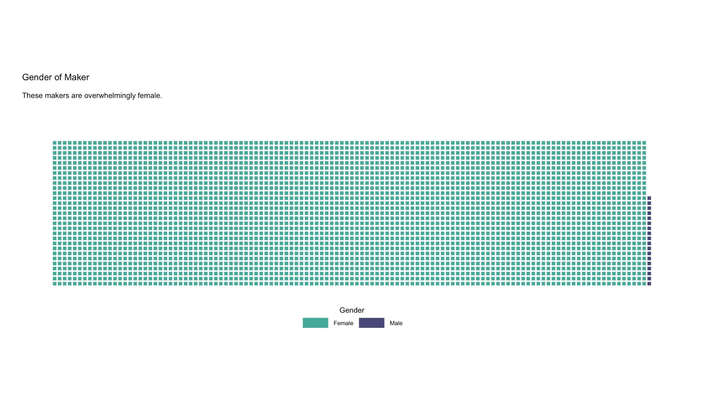

Slide 14
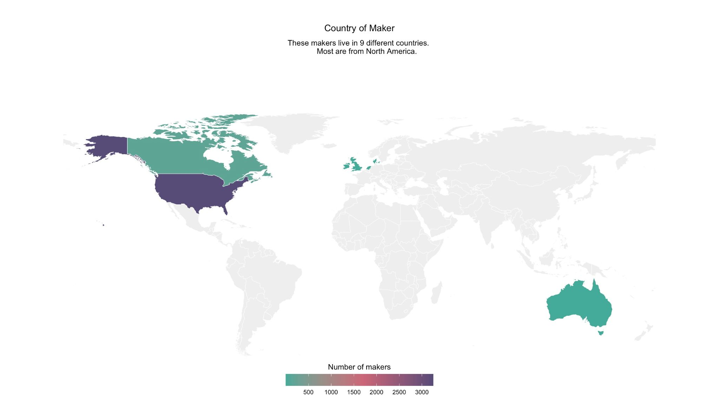
Notes:
Not surprising, since the data was collected in North America.

Slide 15
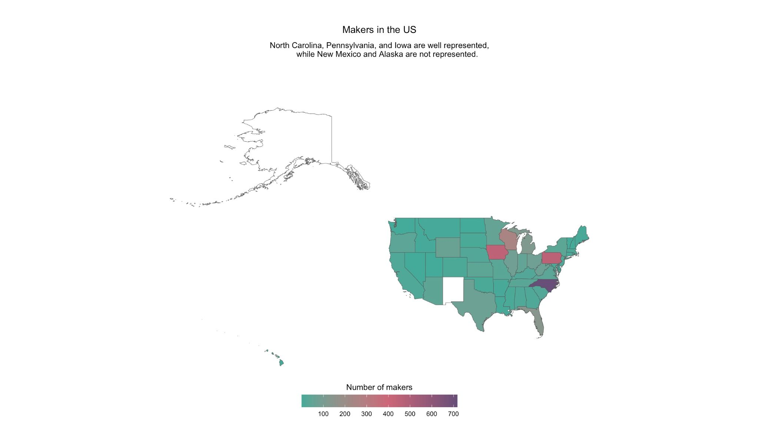

Slide 16
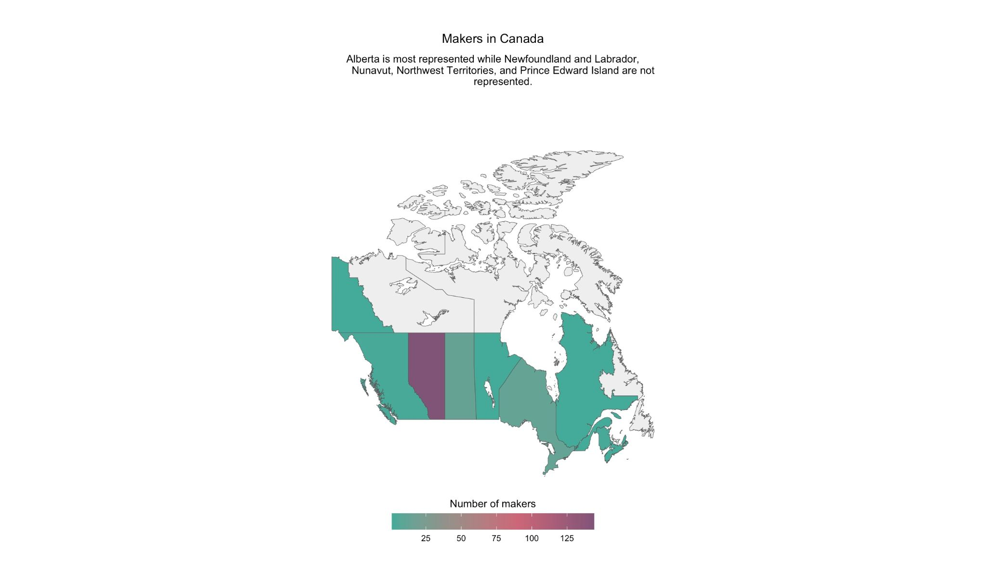

Slide 17
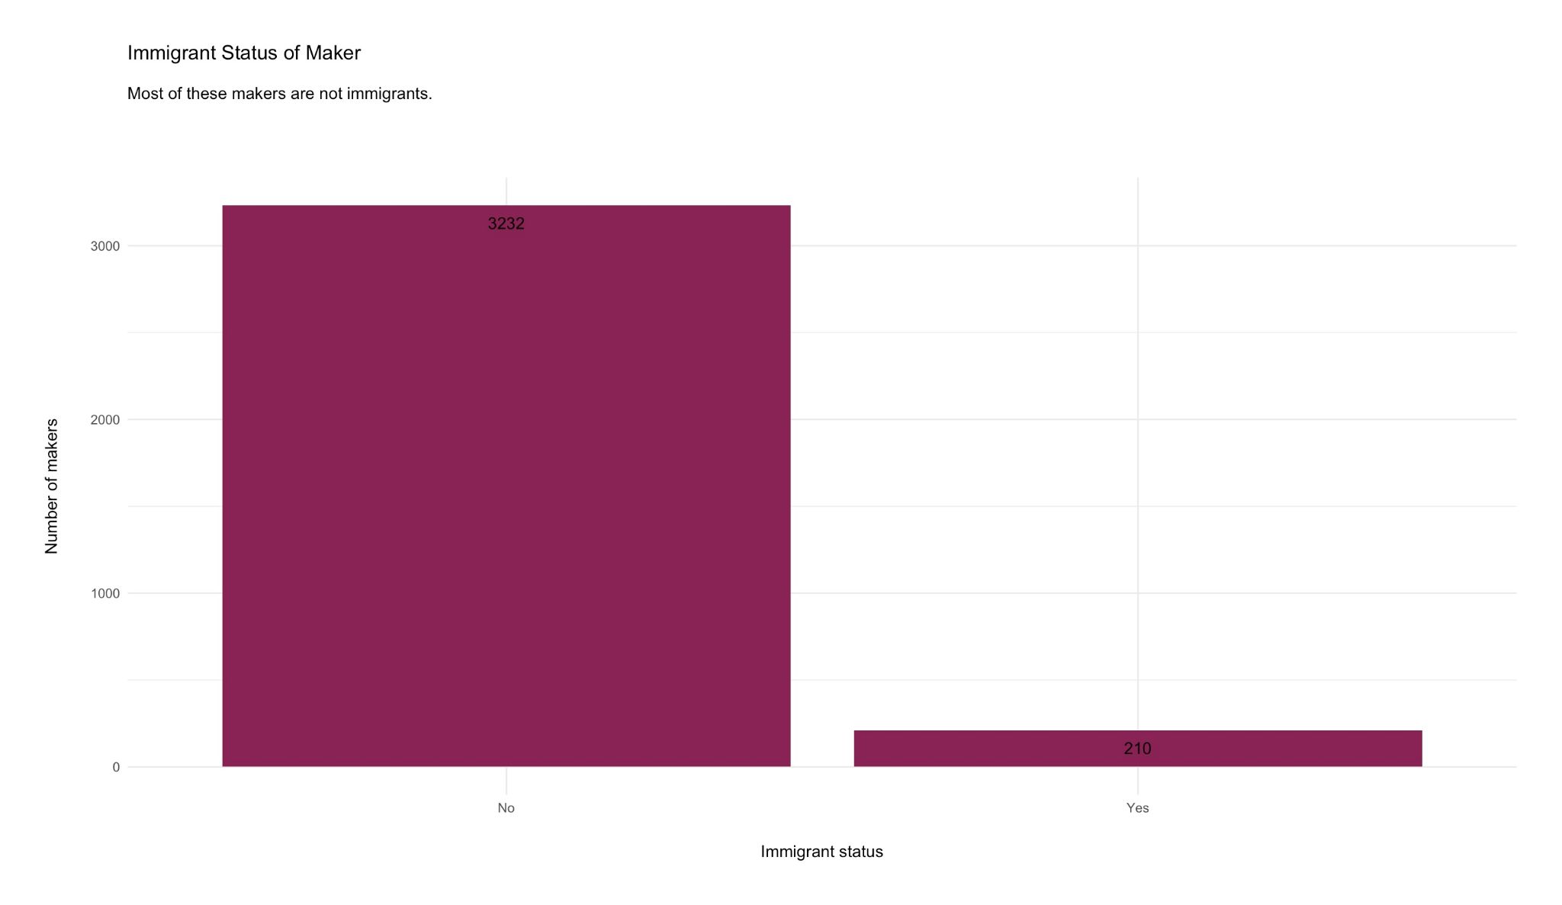

Slide 18
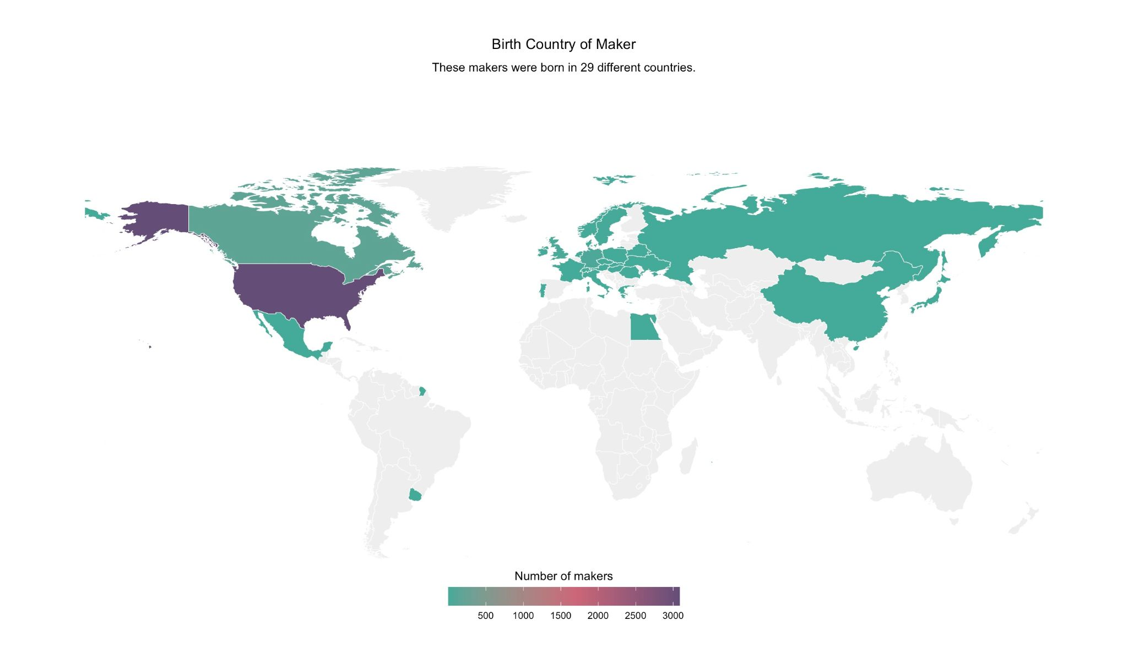

Slide 19
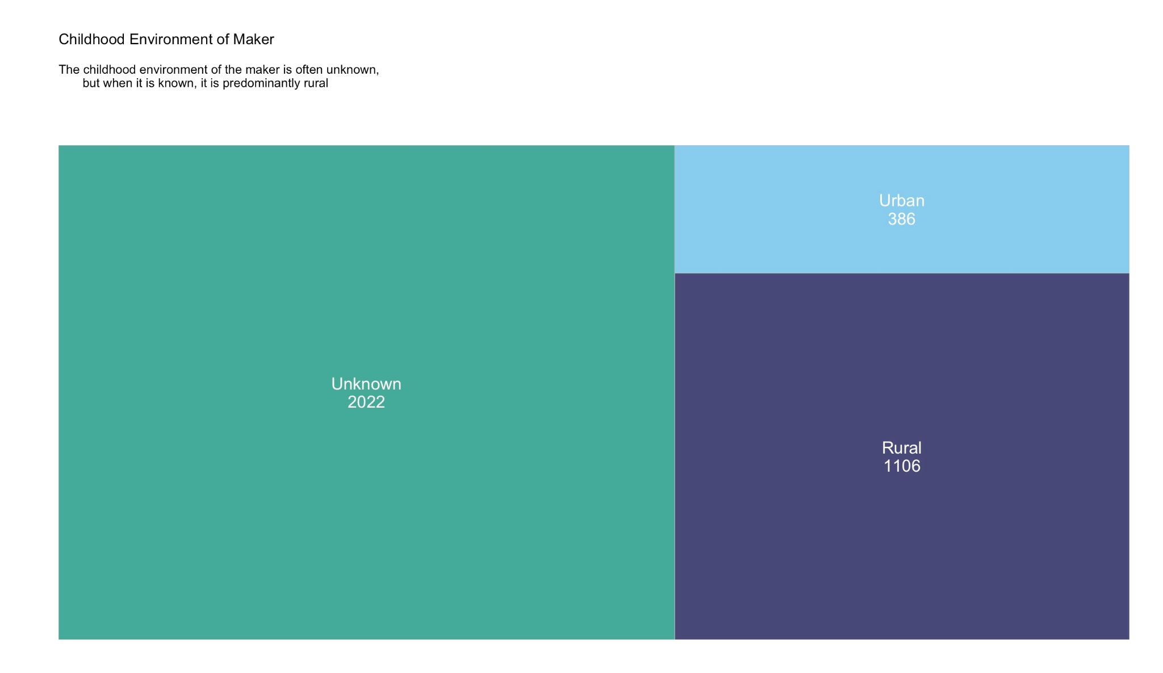

Slide 20
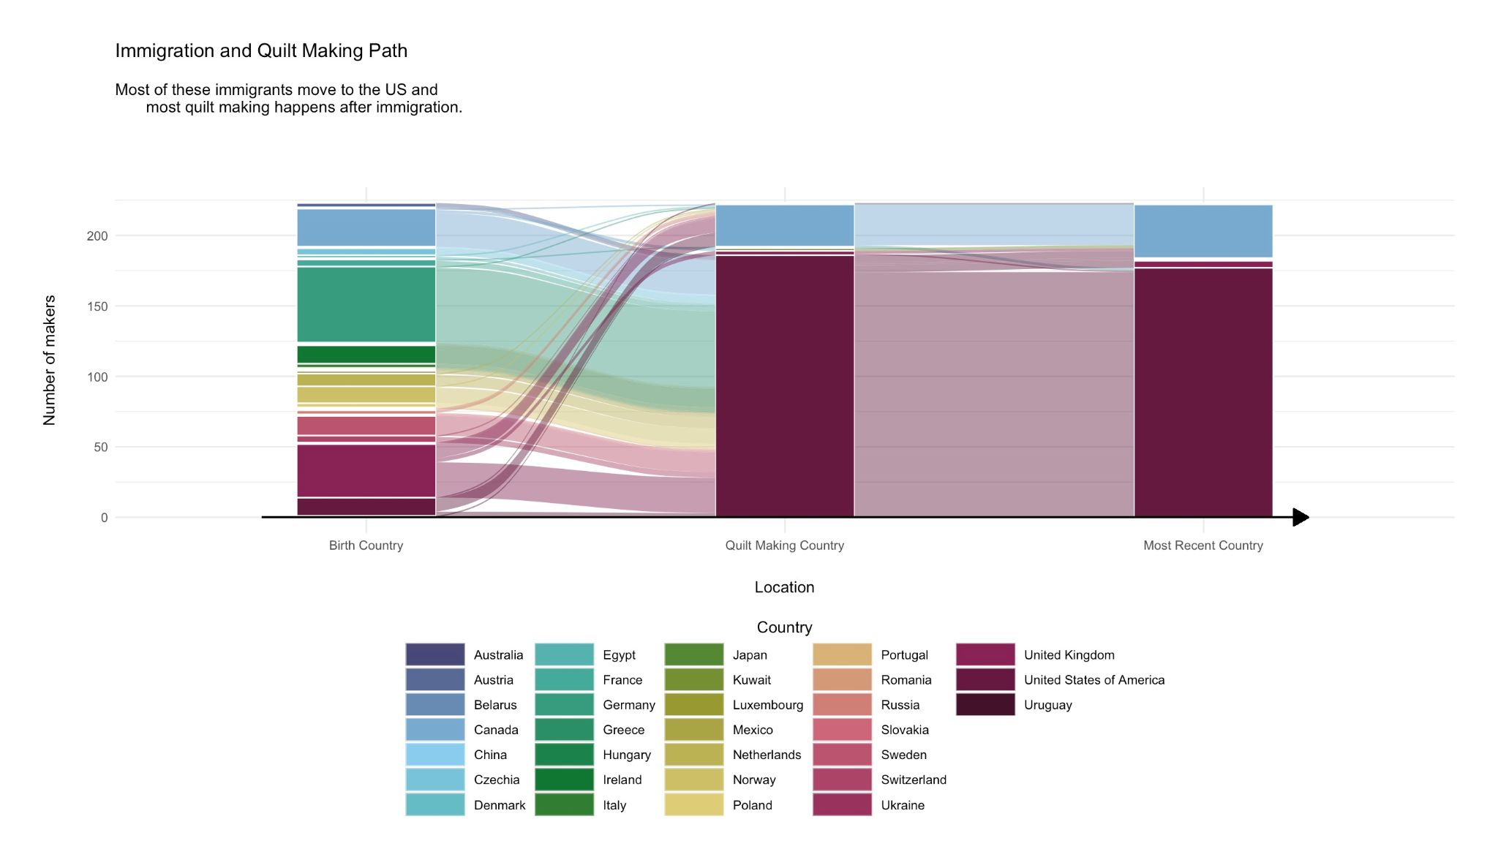
Notes:
The right-hand portion of this graph is also pathways, like in the left-hand portion, but because the quilt makers are so settled at this point it doesn’t even look like paths. There is just very little movement after quilt making begins. It is not clear if settling down leads to quilt making or the other way around, but there does seem to be a correlation between the two

Slide 21
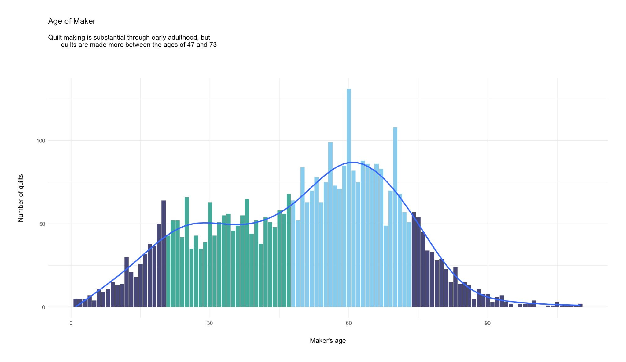
Notes:
So this chart reflects the age of the quilt maker when they made the quilt. It is not clear from this chart if quilt makers begin producing more quilts in middle life or if many people begin quilt making in middle life. Let’s explore more.

Slide 22
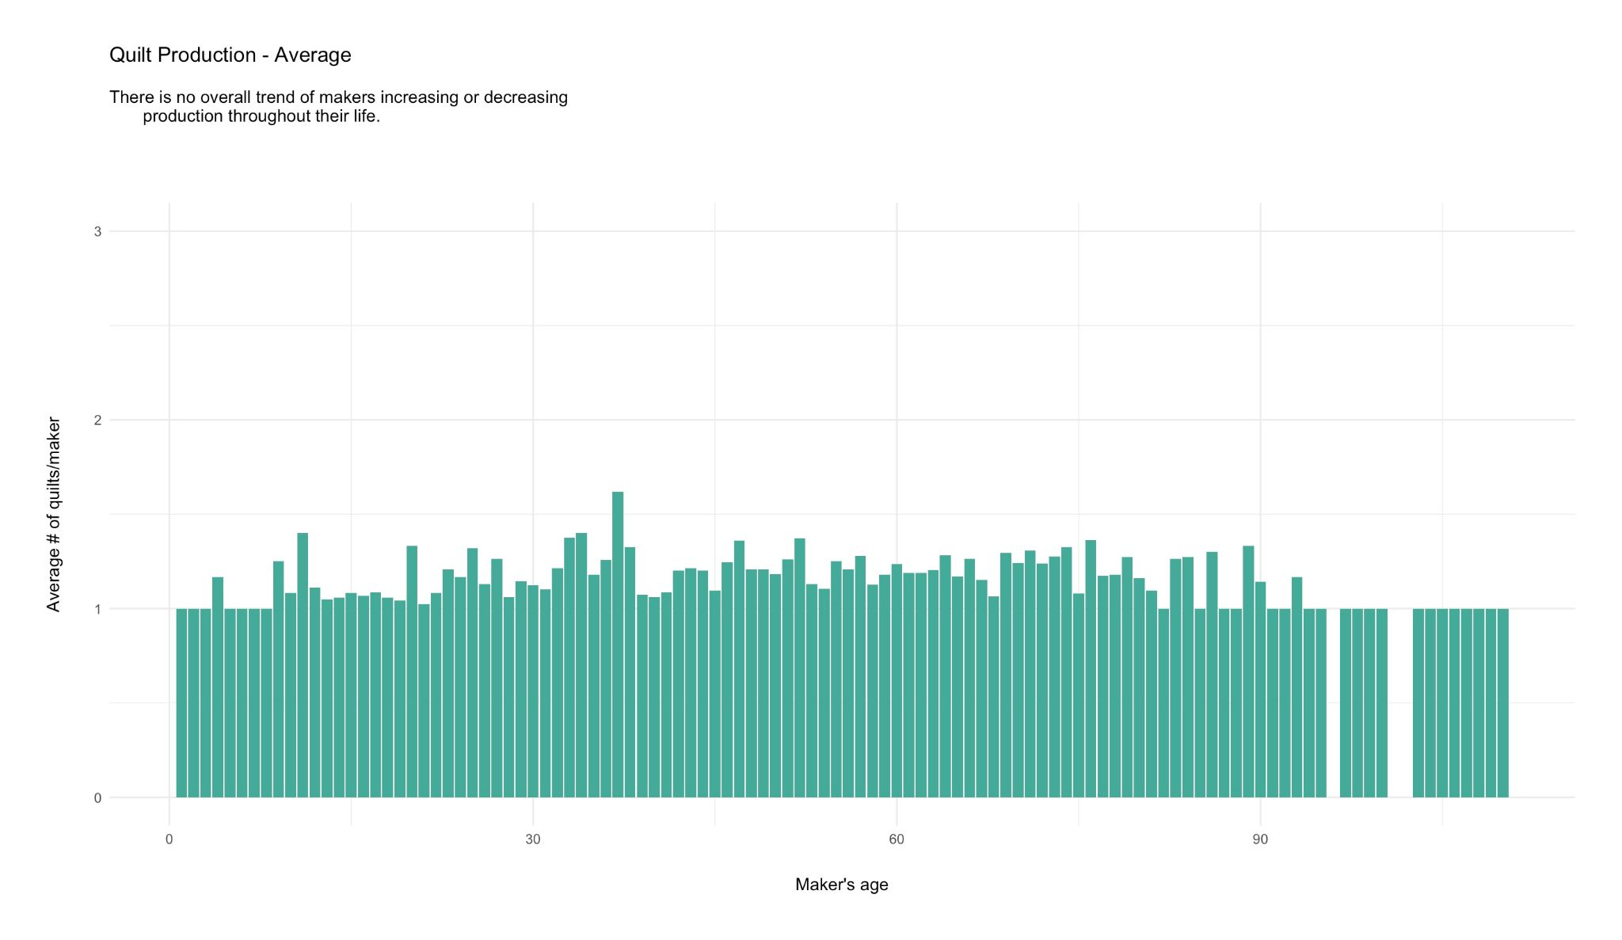
Notes:
Here we see that on average every age is likely to make about one quilt. Maybe two. It’s very stable. We don’t see that everyone begins increasing their production in their middle years. So let’s look at master quilters and see if they are different.

Slide 23
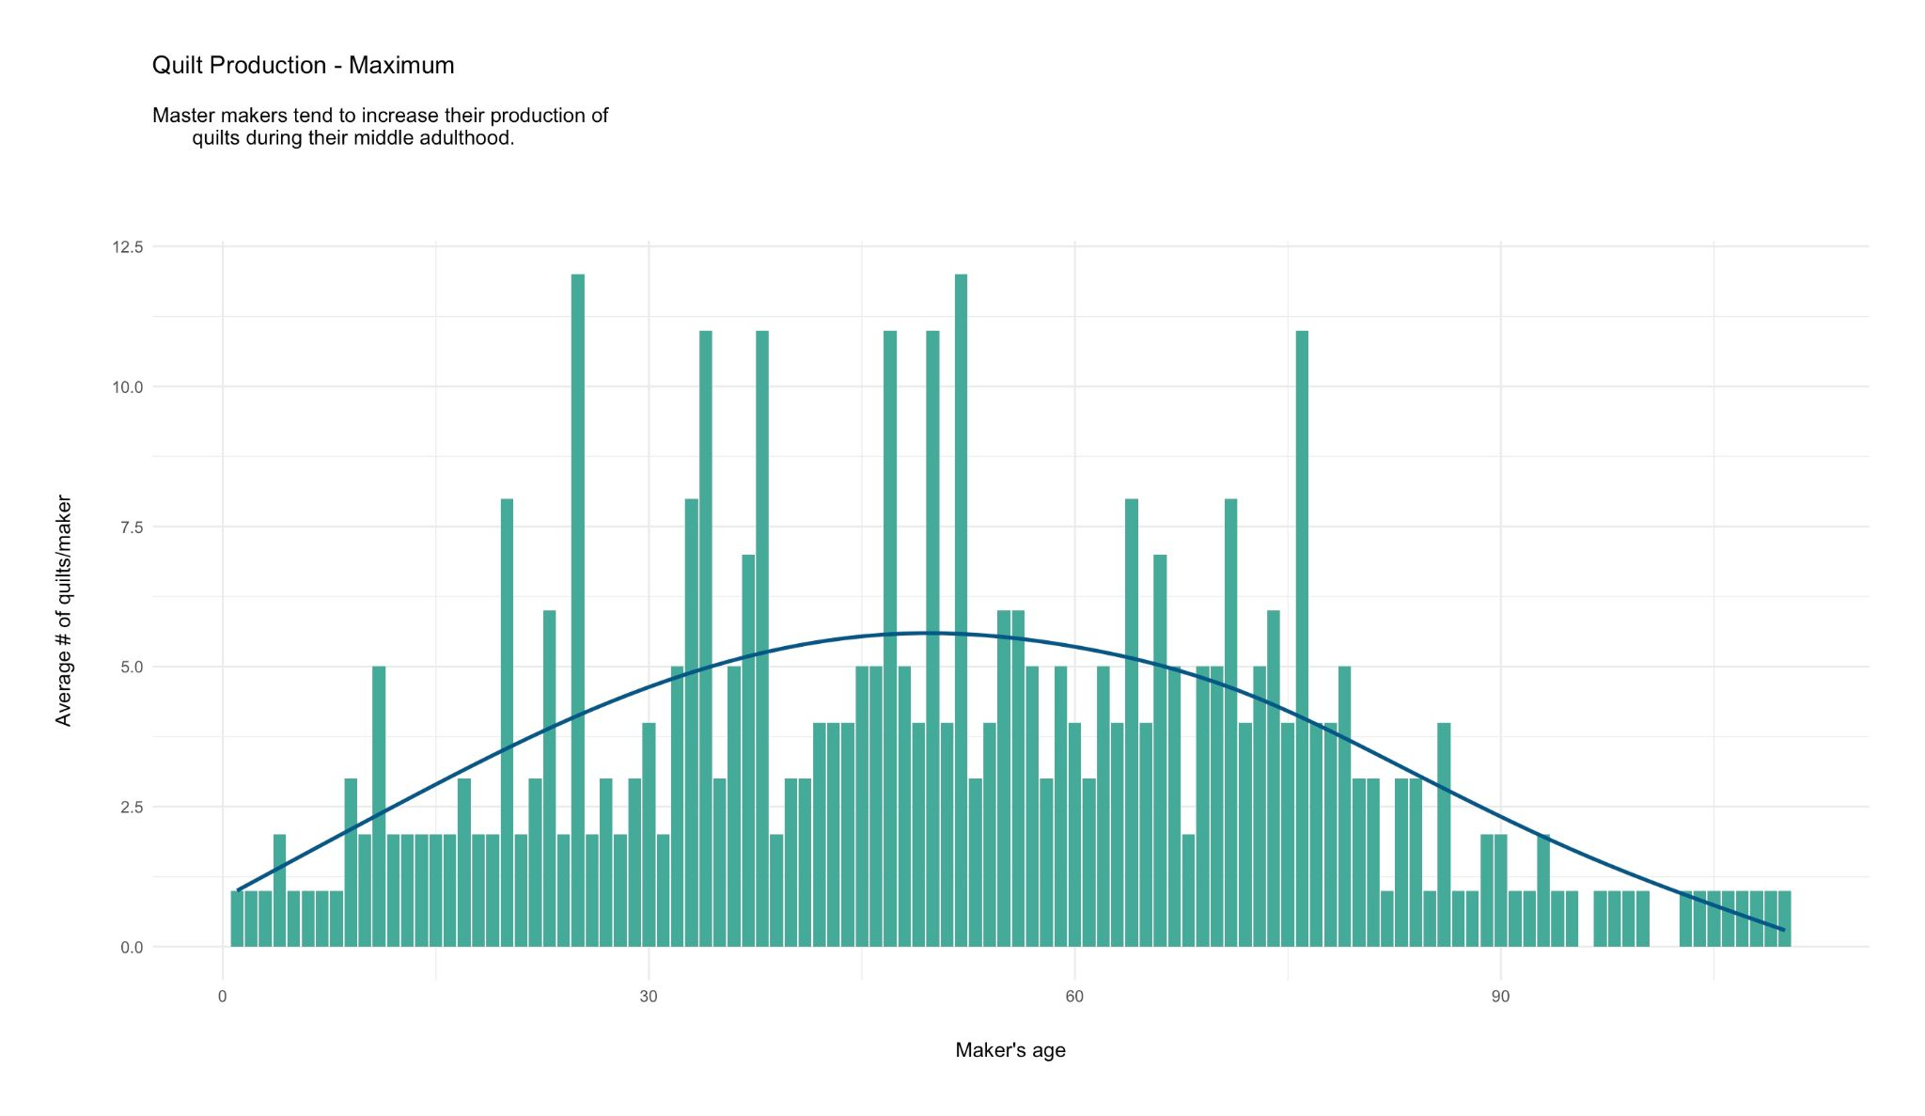
Notes:
Indeed master quilters are a little different. They do increase their quilt production a bit in their middle years. However this doesn’t explain the entire change in quilt production for middle years, so let’s check one more thing.

Slide 24
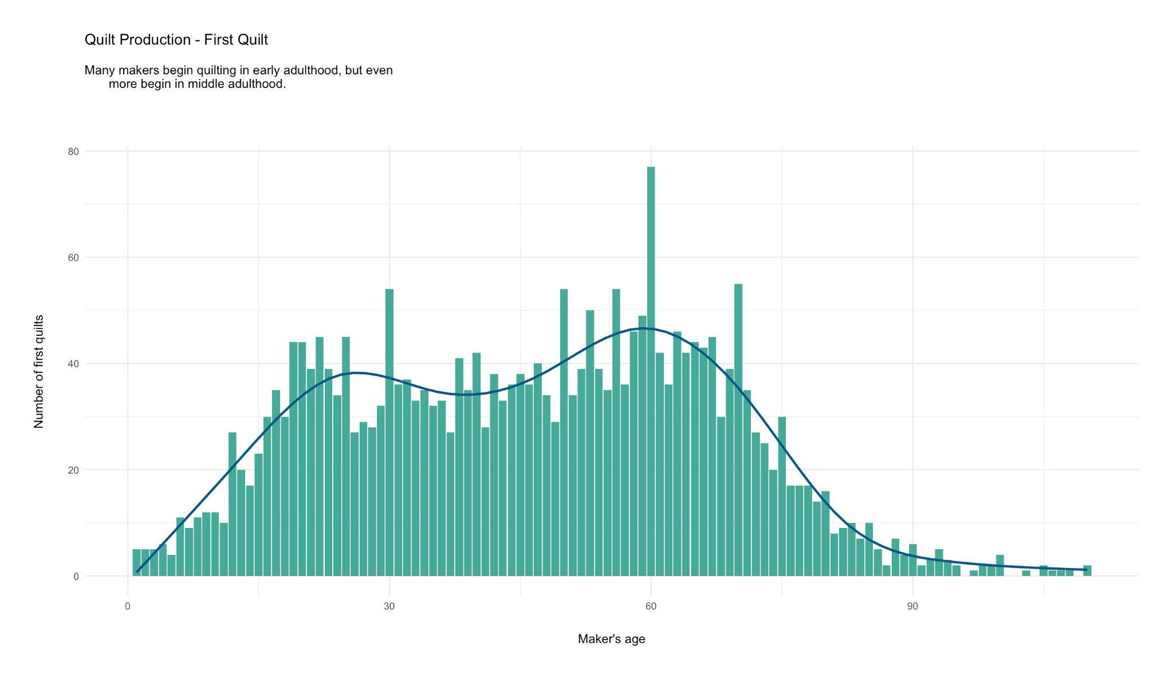
Notes:
OK, here we see when quilt makers make their first quilt. And there is indeed the substantial first quilts in early adulthood, but increased first quilts in middle adulthood. So the quilt production per age can be explained by master quilt makers increasing their production in middle years and by new quilt makers beginning quilt production in middle years.
However, we must remember that the QuiltIndex.org doesn’t have the entire oeuvre for each quilt maker. So, it is possible that “first quilt” in this instance actually represents “first quilt ‘good enough’ to be reported to QuiltIndex.org”. More data would be required to untangle this mystery.

Slide 25
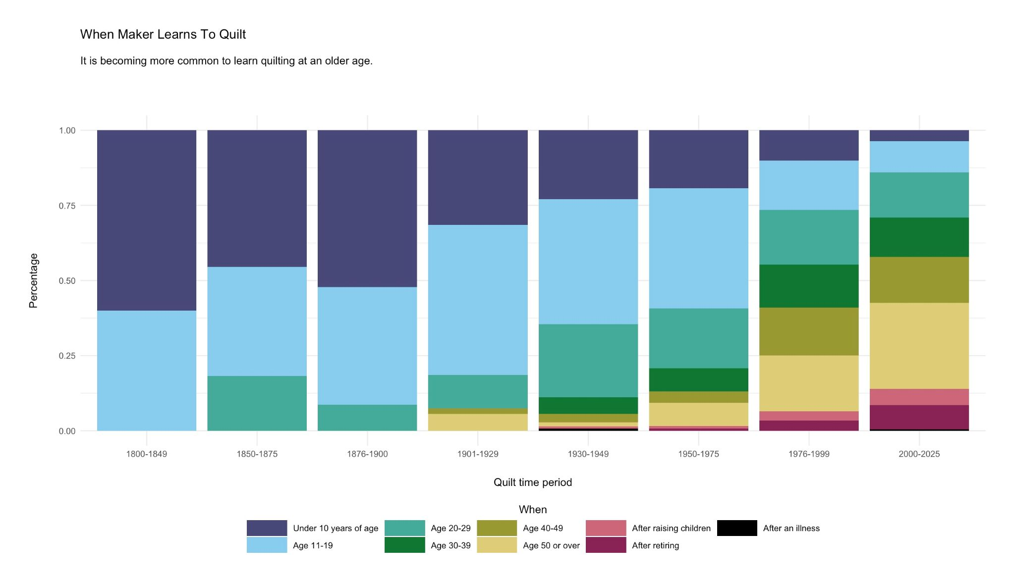

Slide 26
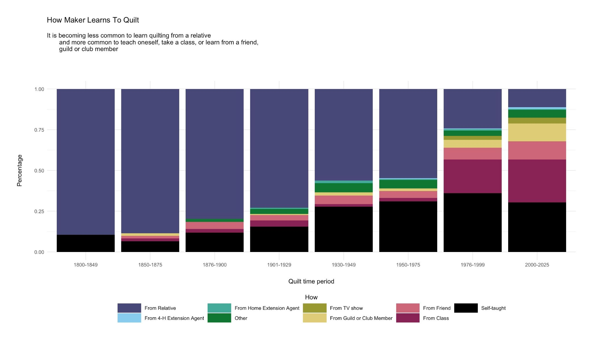

Slide 27
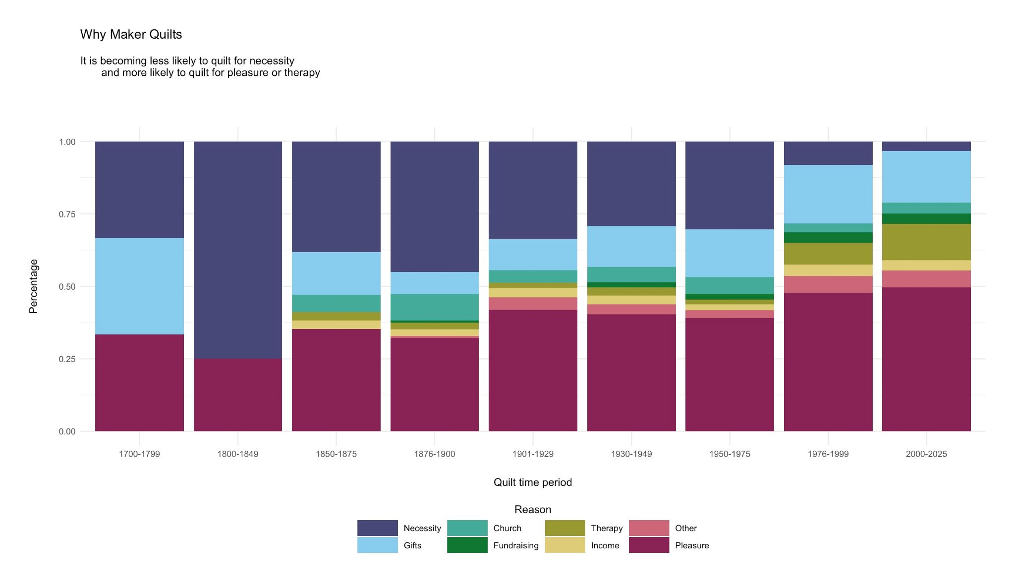

Slide 28
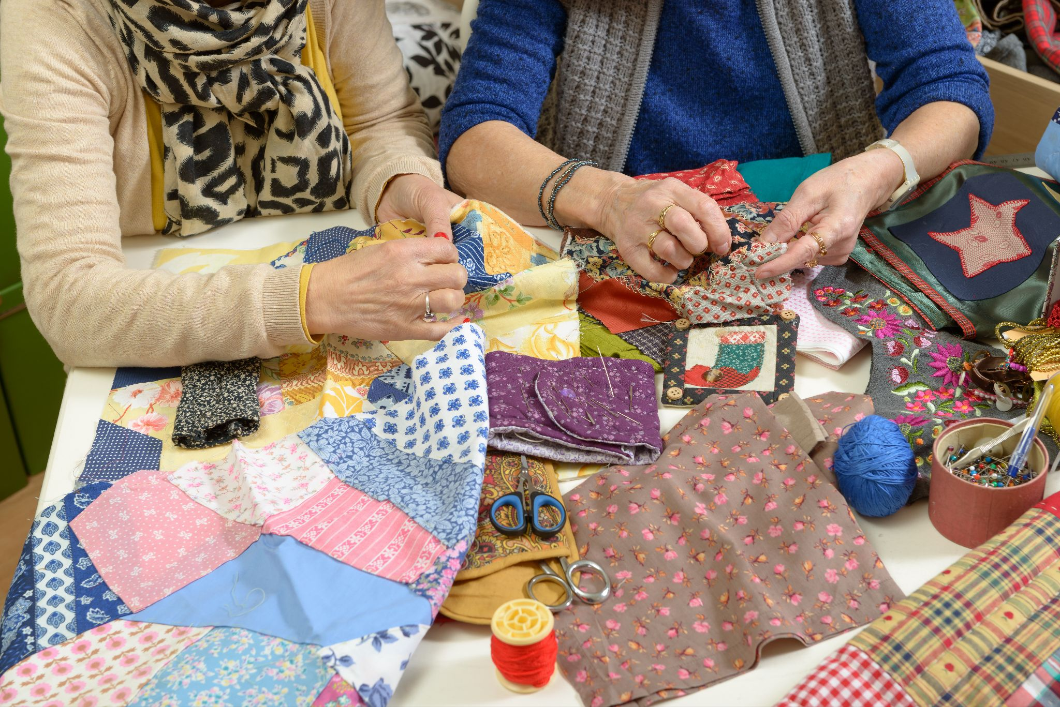
Notes:
Questions?

